Slide 1
PROJECT V
“CMG” LEADING THE WAY TO SAFETY
We thank God for allowing us to see in the spirit and beyond. During our visit to “INSTITUTION CHRETIENNE _ VILSAINT CHERVIL” in Haiti, we saw students, teachers and the founder all brushing their bodies against the wall while they were walking on the ledge in fear of their safety. During this time of the tour we began to walk upstairs. All of a sudden, we realized the fear everyone else had while walking on the ledge. Abruptly, I had to ask, “Sir, this is not safe for you, the children and teachers to walk daily from one classroom to another.” He responded, “I know but we do not have the funds.” Immediately, CMG provided funds for the installation of the railings for the ledge.
“CMG” is about total transformation which means beyond our daily assistance. When we see a need; there is an opportunity to bring solutions and make lives better.
We thank God He blessed us to complete this project before we left Haiti.

Slide 2
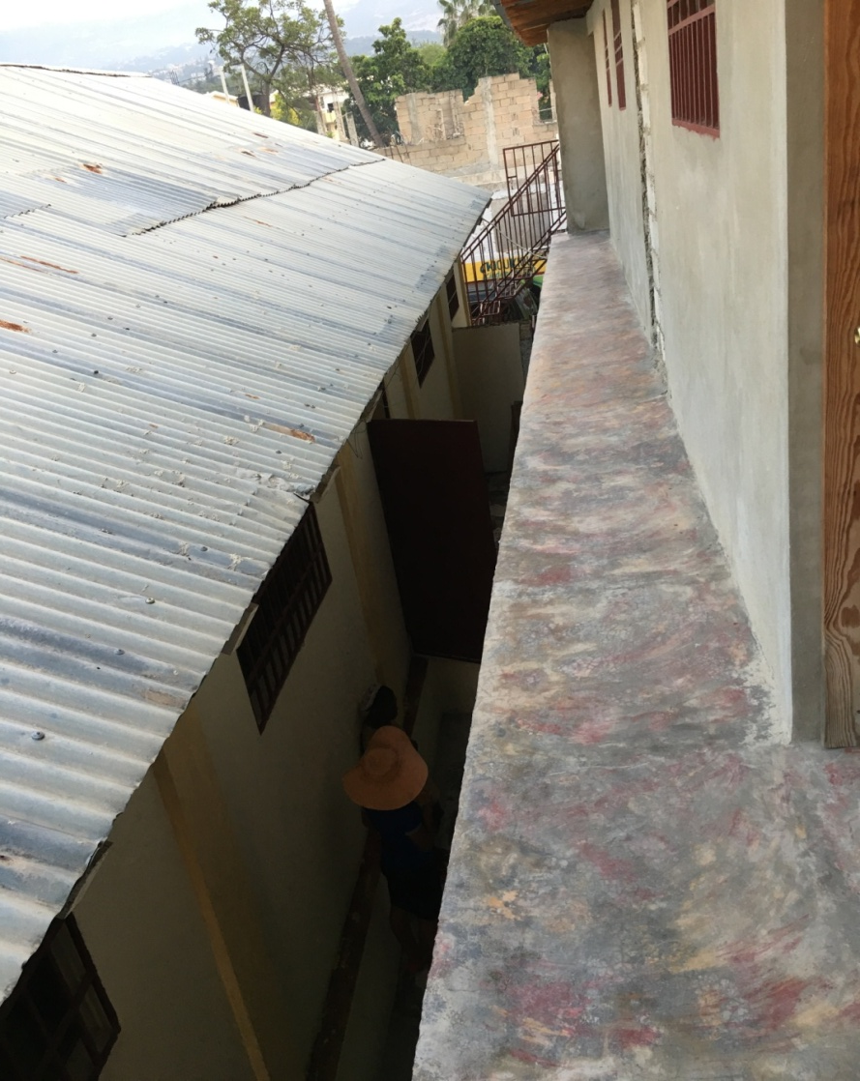
SAFETY ISSUES AT THE SCHOOL: LEDGE WITHOUT RAILING

Slide 3
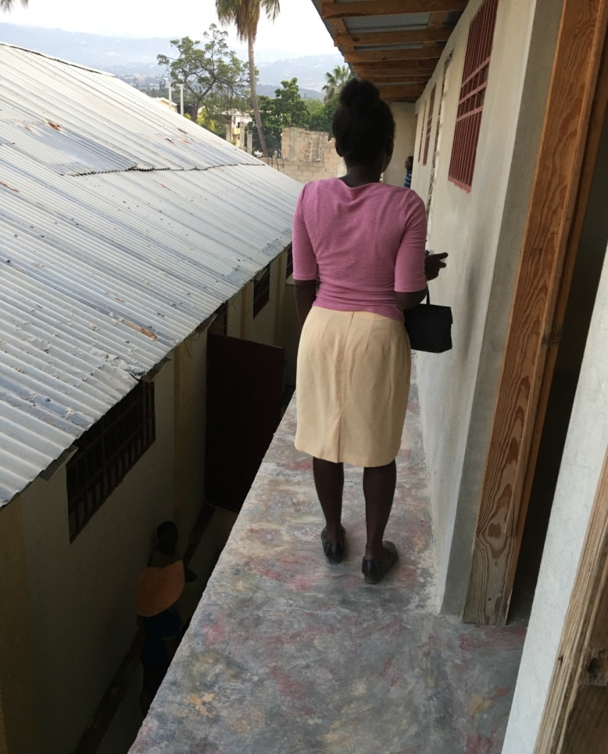
WALKING ON THE SCHOOL LEDGE WITHOUT IT’S RAILING

Slide 4
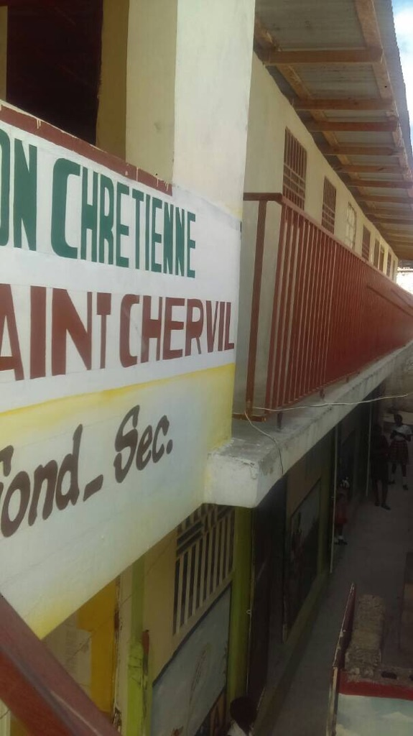
“CMG” Helped Install the Railing BEFORE AFTER

Slide 5
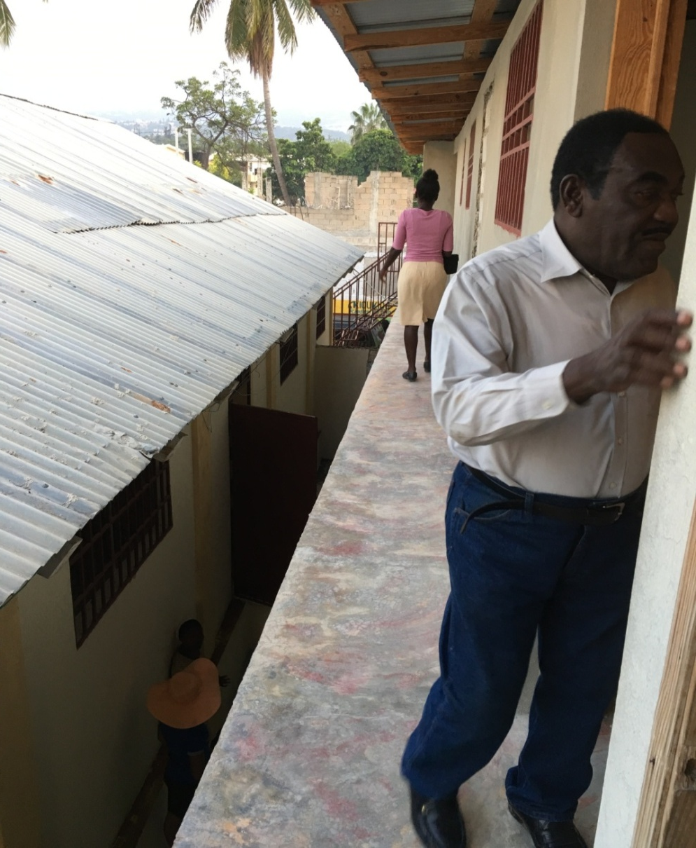
“CMG” Helped Install the Railing BEFORE AFTER

Slide 6
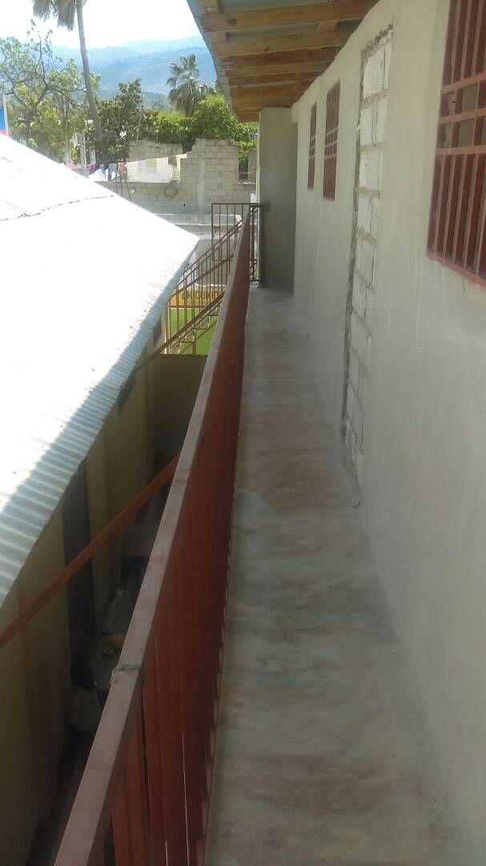
RAILING INSTALLED: We Can Stand Safely

Slide 7
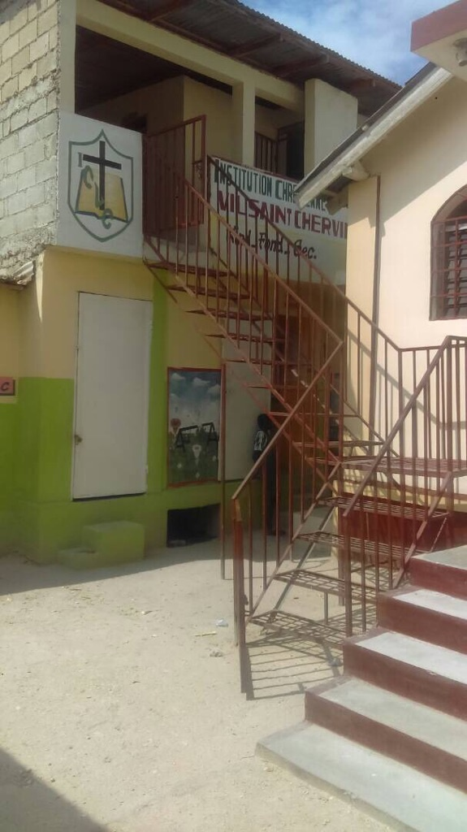
RAILING INSTALLED: SCHOOL SAFETY ISSUE RESOLVED

Slide 8
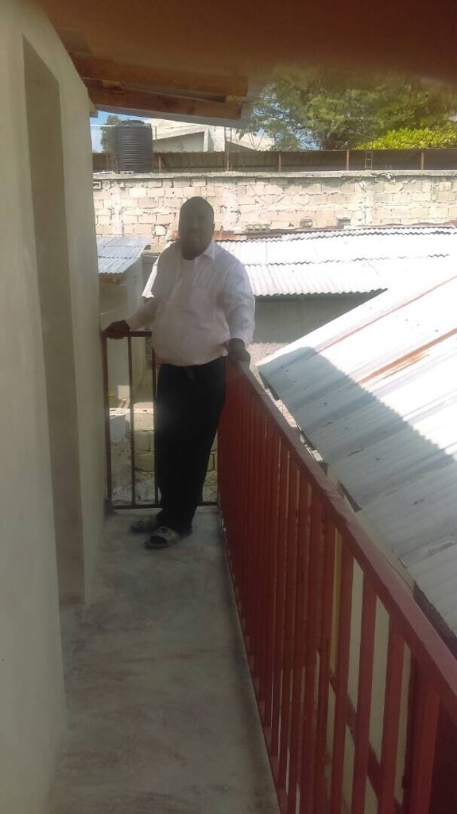
RAILING INSTALLED

Slide 9
PROJECT VI SCHOOL & SANITARIES SUPPLIES
“CMG” supplying students with their needs to keep them focus on just learning. On a quarterly basis, CMG has a budget for supplies to send for outreach programs.
“CMG” had the opportunity to distribute some of the supplies to the students

Slide 10
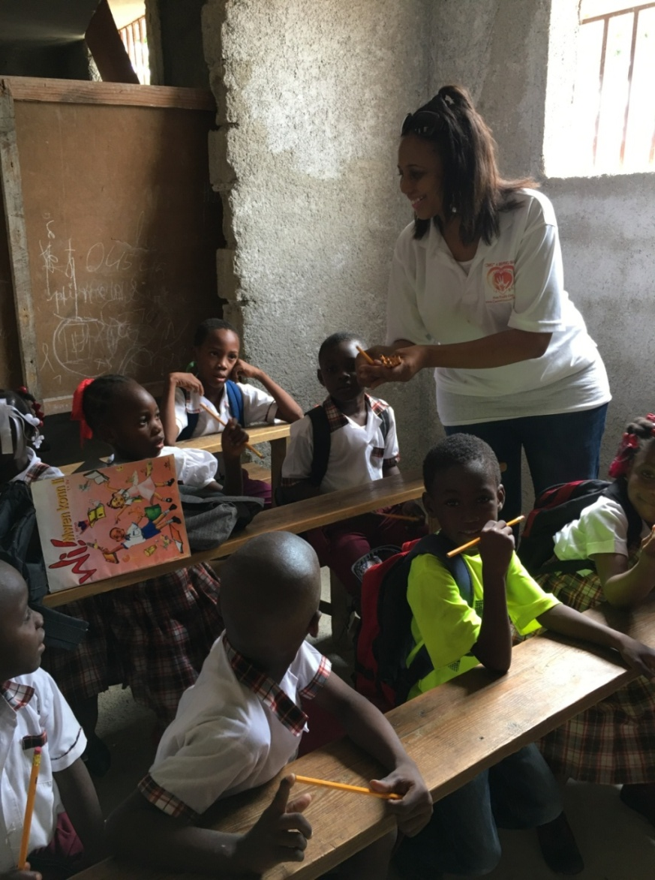
“CMG” DISTRIBUTING SCHOOL SUPPLIES

Slide 11
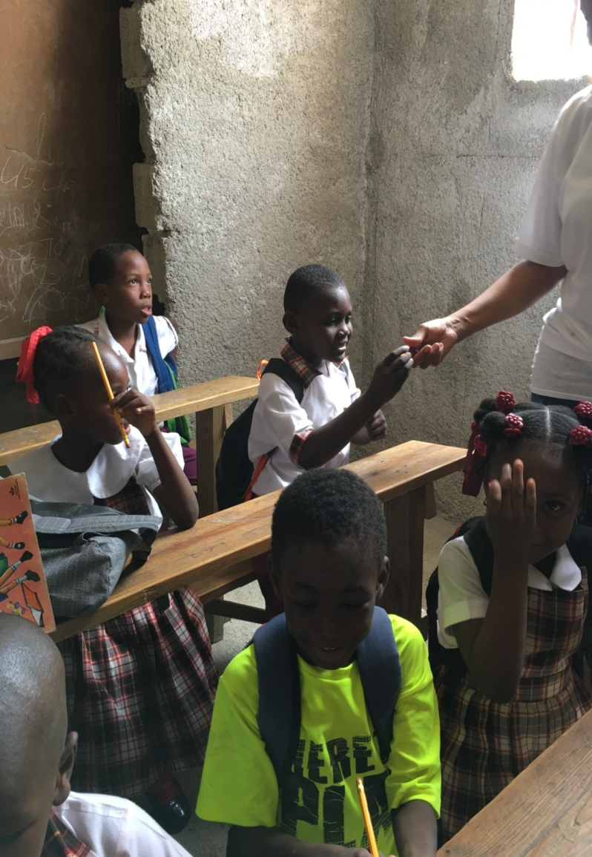
“CMG” DISTRIBUTING SCHOOL SUPPLIES

Slide 12
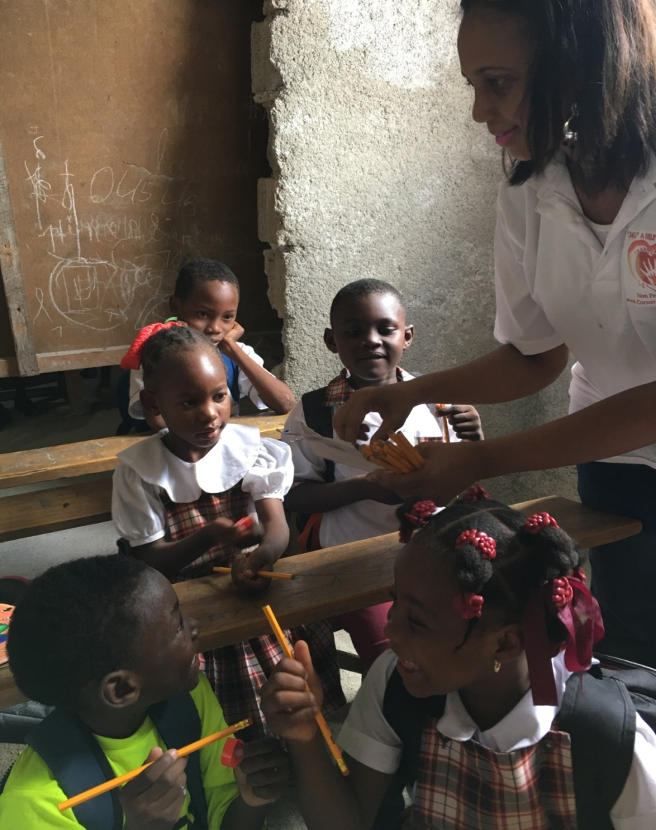
“CMG” DISTRIBUTING SCHOOL SUPPLIES

Slide 13
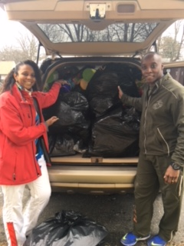
“CMG” _ USA TOYS DISTRUTION

Slide 14
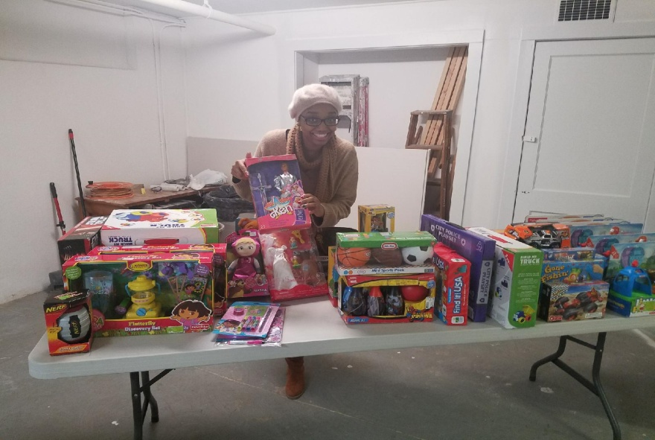
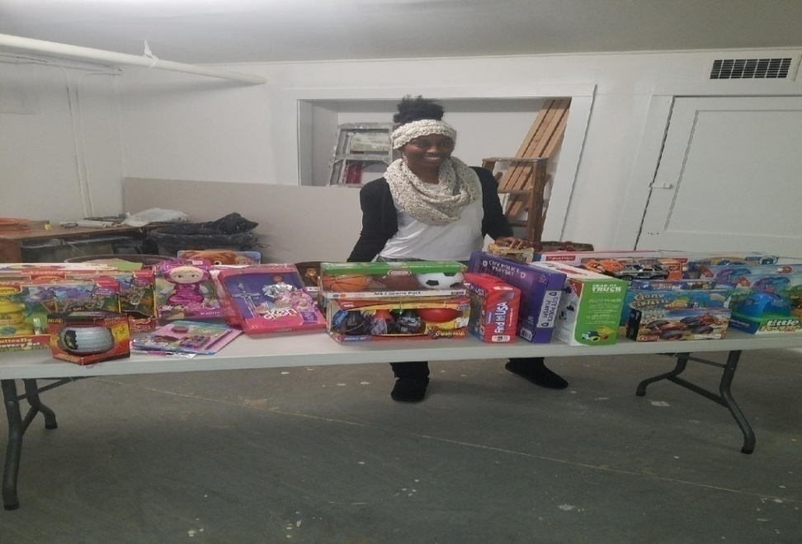
“CMG”_ USA TOYS DISTRIBUTION

Slide 15
CORNERSTONE MOUNT GROUP “CMG” INC. CONTINUOUS ASSISTANCE
FEEDING COMMUNITIES and THEIR CHILDREN
EDUCATIONAL ASSISTANCE to ATTEND SCHOOL
ENVIRONMENT and ECONOMY HELP
SENDING FOOD and SCHOOL SUPPLIES
FINANCIAL ASSISTANCE to help run SCHOOLS
TOYS DISTRIBUTION: USA, AFRICA and HAITI
HEALTH EMERGENCY ASSISTANCE
RESEARCH and INFORMATION

Slide 16
“CMG” _ NEW PROJECTS
SCHOOL needs NEW ROOF for a Classroom
CHURCH needs to be REMODELED
WATER FOUNTAIN for SCHOOLS in various communities
INNOVATIVE TOILET for SCHOOLS & COMMUNITIES
KIDS WALK 5 MILES EACH DAY TO GET TO SCHOOL:
a) CONSTUCTION PROJECTS:
- NEW SCHOOLS
- Kindergarten to Vocational
-Hospitals, Urgent Care Facilities, Businesses, and Homes
b) PURCHASES:
- LAND
- SOLAR PANES
- place on roofs of Hospitals, Urgent Care Facilities, Schools, and Homes
NEED SCHOOL BUSES, SUPPLIES, OTHER TRANSPORTATION

Slide 17
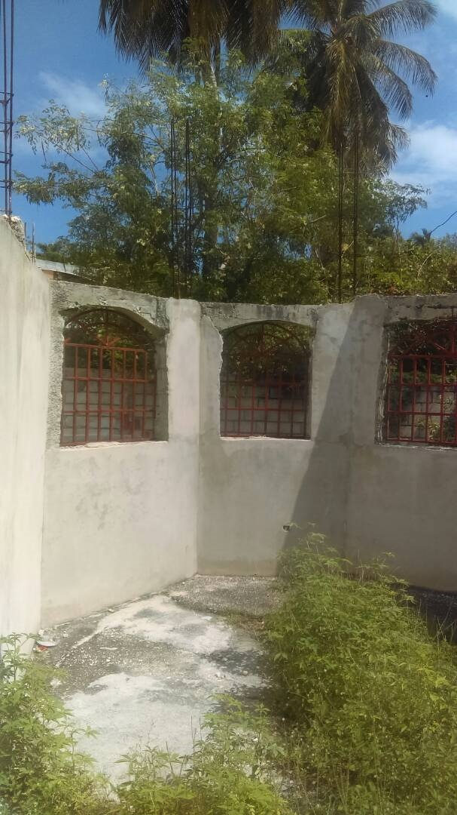
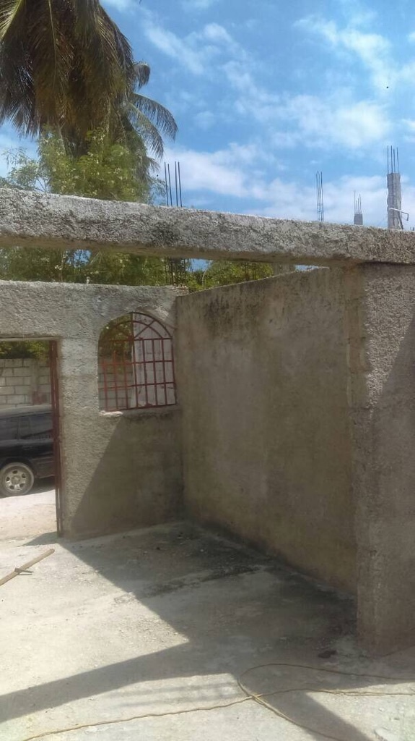
NEW PROJECT
NEW ROOF NEEDED & INSIDE WORK FOR CLASSROOM IN THE SCHOOL – Cost $3,500.

Slide 18
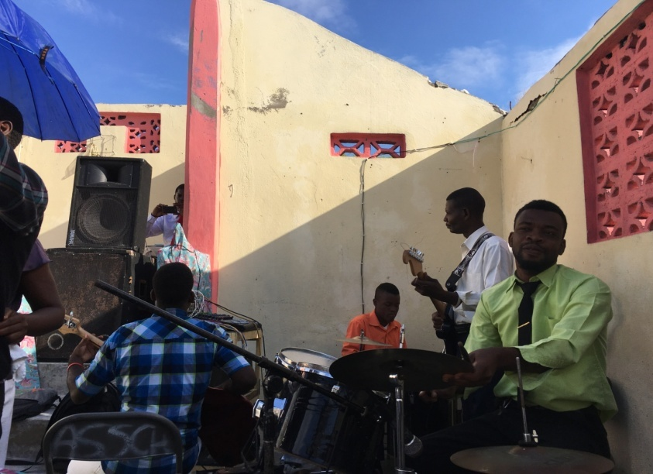
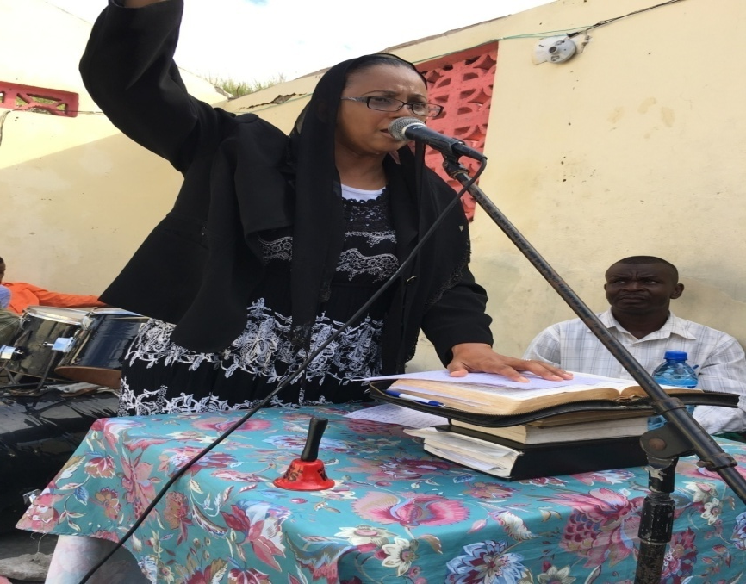
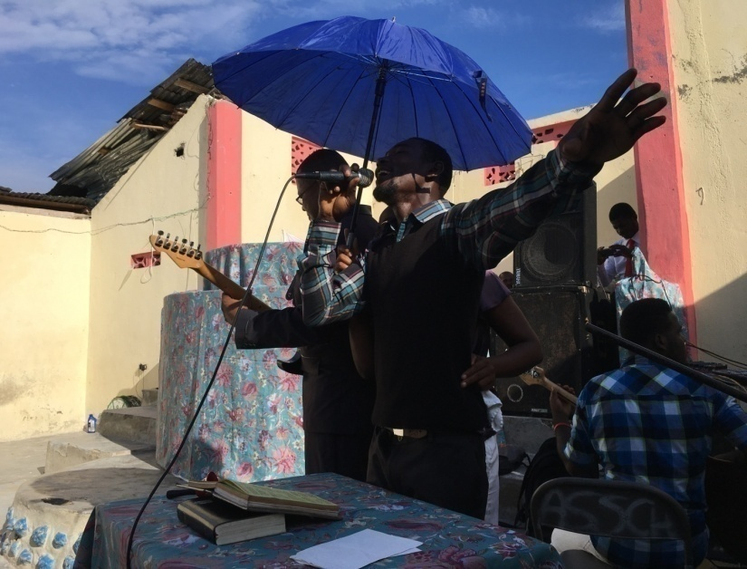
“CMG” NEW PROJECT BUY LAND to BUILD FACILITIES

Slide 19
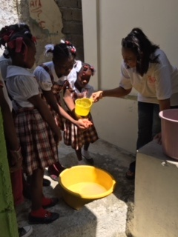
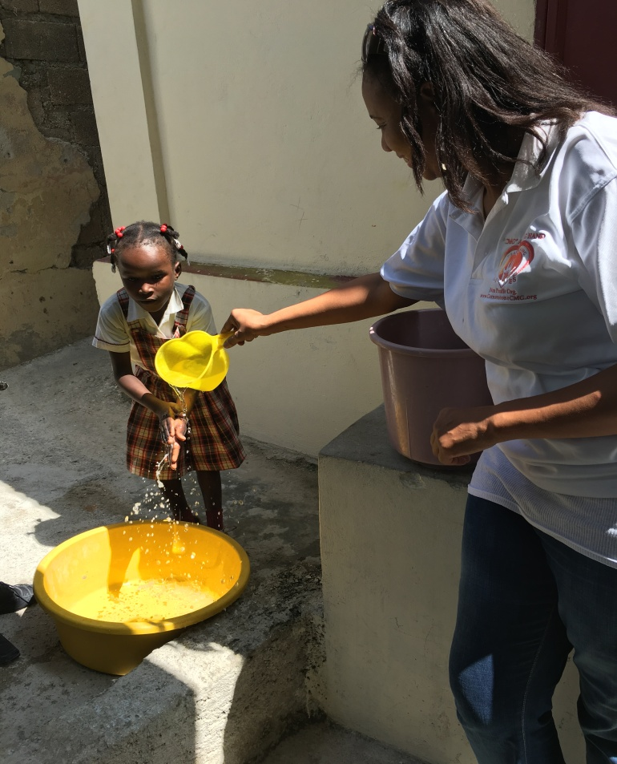
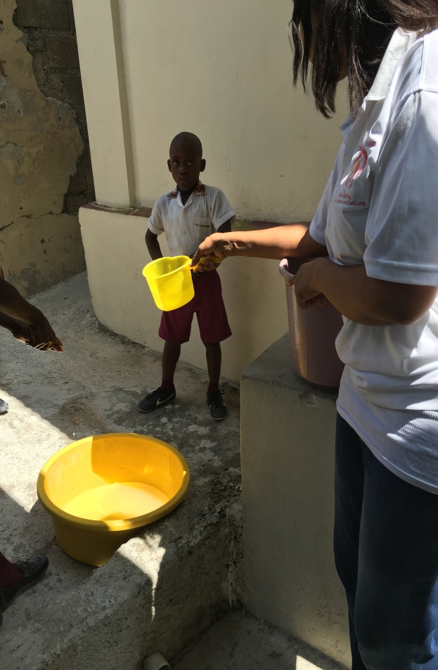
NEW PROJECT
CLEAN WATER TO DRINK
AND
FOUNTAINS FOR SCHOOLS & COMMUNITIES

Slide 20
A REMINDER
1 Timothy 6:7 and 11
7) For we brought nothing into this world and it is certain that we can carry nothing out.
11) Let us come together and follow after righteousness, godliness, faith, love, patience and meekness.

Slide 21
“CMG” Vision and Plan
CMG needs YOUR Love & Support to execute them.
We are asking for your help!
PLEASE DONATE NOW
&
WATCH THE TRANSFORMATION THAT
YOU ARE APART OF!

Slide 22
HOW DO WE MOVE TO NEXT LEVEL
We Need Your Help and Support!
WILL YOU JOIN US?
TOGETHER WE CAN ERADICATE POVERTY, STOP HUNGER and ILLITERACY IN ALL ITS FORMS!
The goal is to meet the needs of today,
without losing one child!
Tomorrow is not promised to no one! We can no longer wait for the next generation to take care of the present generation. Let us use our current resources to build and secure the foundation for our future generations NOT just for the RICH but for ALL.
TOGETHER as One NATION and ONE WORLD!

Slide 23
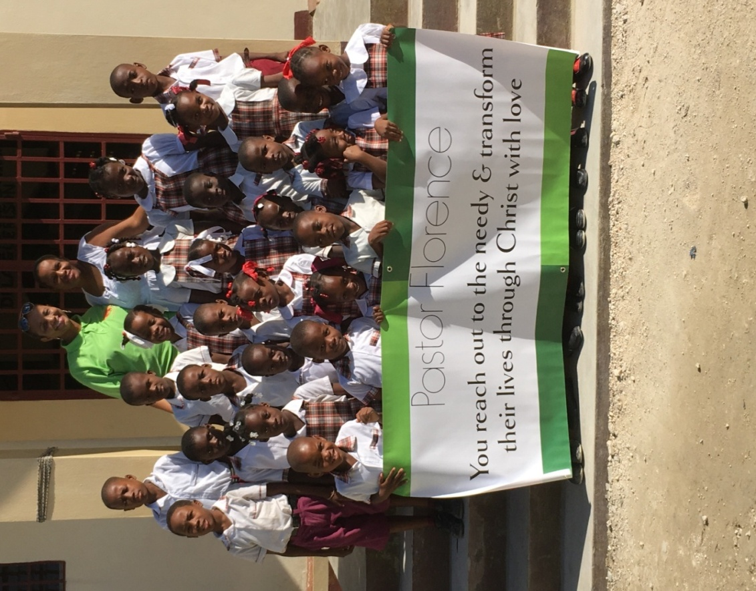
YOUR GIVING MAKE THIS POSSIBLE & WE THANK YOU!

Slide 24
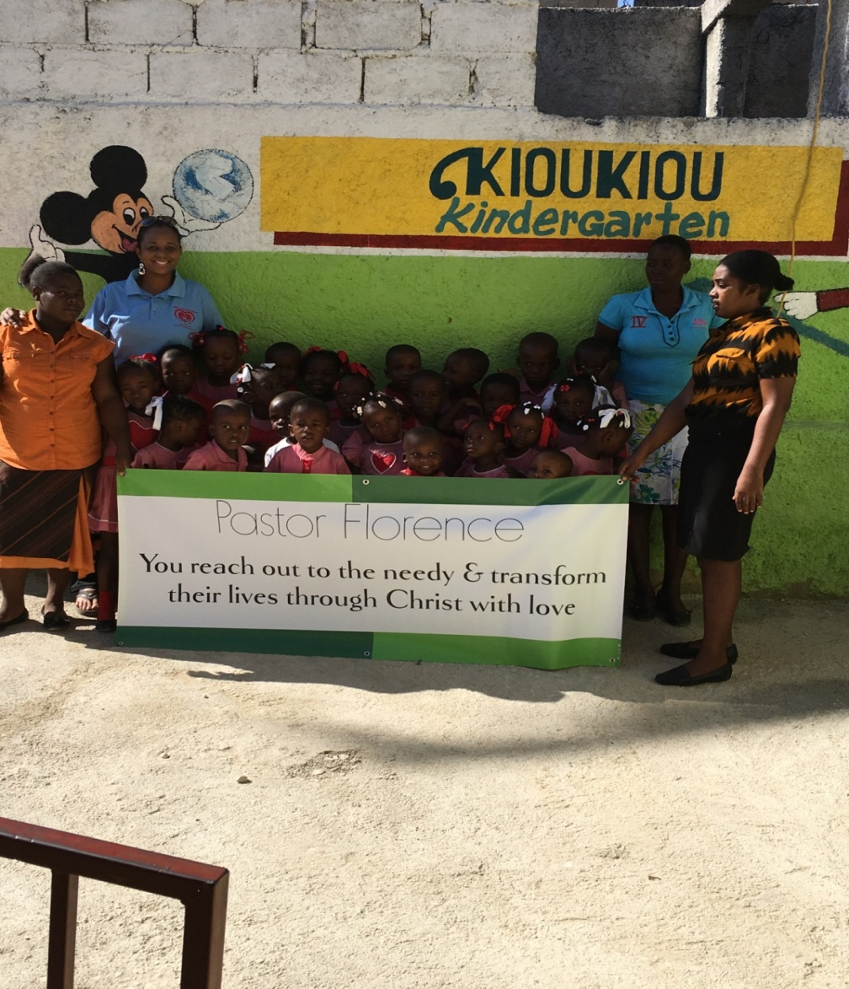
“CMG” IS GRATEFUL. THANK YOU SO MUCH!

Slide 25
“CMG” vision is to take every child out of the street by eradicating Poverty, Illiteracy, Stop Hunger and Equip our children and the next Generations. Your DONATION brings the fruition of Love that will transform lives. TOGETHER! One Child At a Time, One Family At a Time, One Generation at a Time Till we conquer Poverty in all its forms _ Once & For All! DO YOU KNOW WHERE YOUR CHILD IS! THIS CHILD BELOW IS ON THE STREET DUE TO POVERTY! How Long will You and I Watch and Wait! Enough is Enough! LET US TRANSFORM LIVES and DONATE NOW!

Slide 26
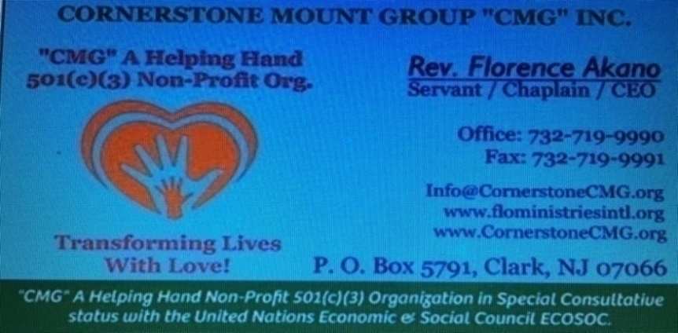
AS A PARENT DO YOU CARE ABOUT YOUR CHILDREN’S WELFARE? STILL THIS CHILD BELOW IS ON THE STREET DUE TO POVERTY! WE DON’T HAVE MUCH TIME! Again My question to US? How Long Will You & I Watch, Wait And DO NOTHING! Enough is Enough! LET US TRANSFORM LIVES! Go to: www.CornerstoneCMG.org and CLICK The DONATE Button NOW!
TOGETHER WITH LOVE LET US GIVE A GIFT OF LOVE TO HELP SAVE THIS CHILD AND THE OTHERS!

Slide 27
CORNERSTONE MOUNT GROUP “CMG” INC. P. O. Box 5791, Clark NJ 07066 / www.CornerstoneCMG.org / 732-719-9990 WE WOULD LIKE TO TAKE THIS OPPORTUNITY TO THANK GOD AND EACH ONE OF YOU BECAUSE WITHOUT YOU IT WILL NOT BE POSSIBLE!
TOGETHER WITH LOVE LET US CONTINUE TO GIVE AND BE A BLESSING WHICH WILL HELP SAVE THIS CHILD AND OTHERS. YOUR DONATION IS A GIFT OF LOVE THAT WILL ALLOW CMG TO CONTINUE THE MINISTRY AND START WORKING ON NEW PROJECTS THAT WILL EQUIP OUR COMMUNITIES AND NATIONS.
AGAIN, THANK YOU SO MUCH FOR BEING A BLESSING THROUGH CMG TO NATIONS.
I PRAY BLESSING AND FAVOR OF GOD UPON EACH ONE OF YOU, YOUR FAMILY, YOUR GENERATIONS AND MINISTRY IN JESUS CHRIST NAME AMEN.
I LOVE YOU AND THERE IS NOTHING YOU CAN DO ABOUT IT!
SHALOM & AGAPE LOVE,
REV. FLORENCE AKANO & OUR TEAM

